Slide 1
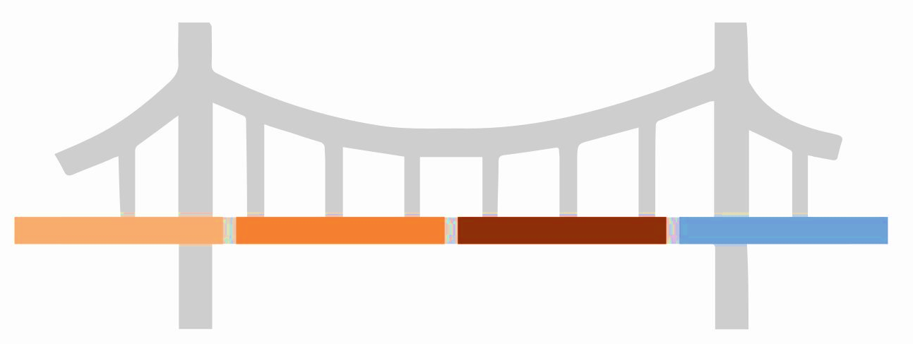
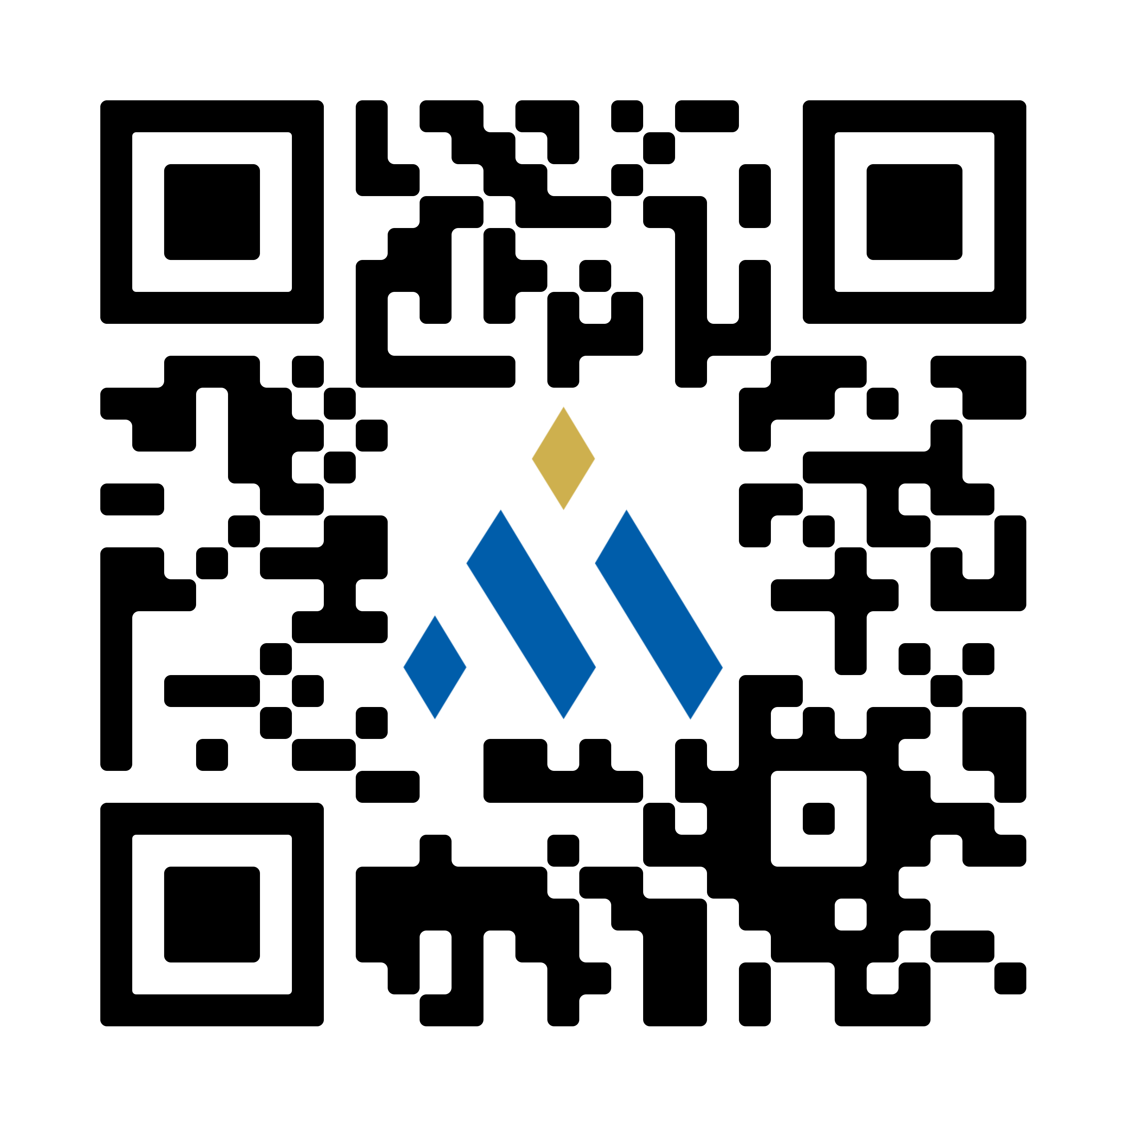







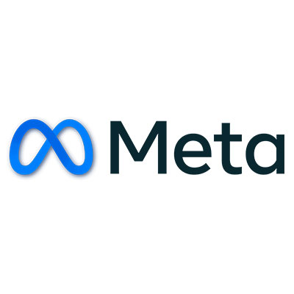
Bring the Management Consulted training program to your organization and become a trusted advisor for your key stakeholders
This approach is the bridge that takes you from ineffective to influential!
Hard to understand slides
Ineffective meetings
Disengaged stakeholders
Ideas that don’t turn to action
Clear slides with firm takeaways
Effective and efficient meetings
Engaged stakeholders
Ideas that lead
to action
Where your team is now
Pyramidal Communication Framework
Where your team will be post-training
Scan to learn more about a training program trusted by partners including:

Slide 2
SCR Template: This is the 1st slide of your deck and sets context for what’s to come
Where we were
What’s changed
Today’s focus
[Briefly describe the current state or background. What’s going on? What’s already known or understood?]
Introduce the challenge, issue, or change. What’s different now? What’s the tension point?
Offer a solution, recommendation, or clear action plan. What should be done next? What’s the benefit of doing so?
The Situation – Current state or historical context critical that’s critical to know
The Complication – What changed to introduce tension to the story?
The Resolution – Key takeaway of meeting. Limit to ~10 words, include both “What” & “Why” components.

Slide 3
SCR Example: This is the 1st slide of your deck and sets context for what’s to come
Where we were
What’s changed
Today’s focus
Nike has long been the dominant player in the U.S. athleticwear space due to its emphasis on innovation and strong brand equity.
Our U.S. market share is declining as upstart competitors gain traction, revenue growth is slowing, and distributor relationships are frayed due to our emphasis on selling through direct channels. These factors are directly contributing to declining EBITDA.
Nike should acquire Adidas to grow revenue 15% and EBITDA >3%
The Situation – Current state or historical context critical that’s critical to know
The Complication – What changed to introduce tension to the story?
The Resolution – Key takeaway of meeting. Limit to ~10 words, include both “What” & “Why” components.

