Slide 1
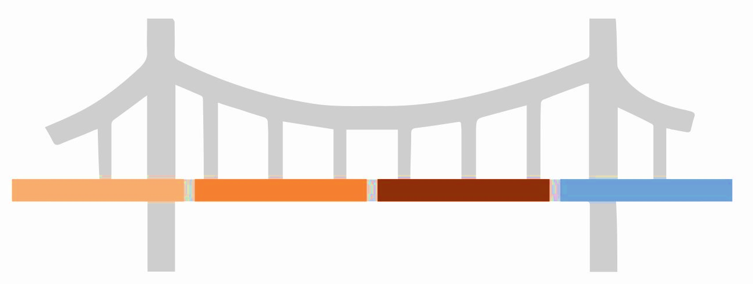









Bring the Management Consulted training program to your organization and become a trusted advisor for your key stakeholders
This approach is the bridge that takes you from ineffective to influential!
Hard to understand slides
Ineffective meetings
Disengaged stakeholders
Ideas that don’t turn to action
Clear slides with firm takeaways
Effective and efficient meetings
Engaged stakeholders
Ideas that lead
to action
Where your team is now
Pyramidal Communication Framework
Where your team will be post-training
Scan to learn more about a training program trusted by partners including:

Slide 2



A pyramidal communication framework enables you to take a hypothesis-driven approach to problem-solving and storytelling
This communication is framed by sharing context in an initial slide.
That slide leads right into the key takeaway, which we call the Assertion.
This is followed by up to 3 Arguments that support the Assertion and make up the chapters of your story.
Inside of each Argument chapter, include selective and curated of Data to support that Argument.
Assertion
This is the one key takeaway of your presentation. Limit it to ~10 words, ensure it includes both a “What” and “Why” component, and tailor it your stakeholders’ needs.
Arguments
These are the pieces of supporting rationale for your Assertion. What does your audience need to believe to buy the Assertion? Limit yourself to three Arguments.
Data
This is the factual support for your Arguments. Don’t include all the data! Be selective - what is the most important information your stakeholders need to see? Limit yourself to 3-5 data slides per chapter.

Slide 3
SCQ Example: This is the 1st slide of your deck and sets context for what’s to come
Where we were
What’s changed
Today’s focus
Nike has long been the dominant player in the U.S. athleticwear space due to its emphasis on innovation and strong brand equity.
Our U.S. market share is declining as upstart competitors gain traction, revenue growth is slowing, and distributor relationships are frayed due to our emphasis on selling through direct channels. These factors are directly contributing to declining EBITDA.
How do we reignite revenue growth and EBITDA expansion in the U.S.?
The Situation – Current state or historical context critical that’s critical to know
The Complication – What changed to introduce tension to the story?
The Question – What then needs to be answered as a result? This is the question you’ll answer today.

Slide 4
Executive Summary Example: Start the meeting with a turbocharged agenda and clear story arc to gather immediate audience reaction
Recommendation
Substantial revenue growth
Revenue projections show that acquisition would lead to 20%+ growth
Nike should acquire Adidas to grow revenue 15% and EBITDA >3%
EBITDA margin accretion
Acquiring Adidas would produce 600+ basis points of EBITDA margin accretion
Largest global fitness retailer
Combined entity would control ~33% of the market, making it the largest fitness retailer in the world
This is the Assertion – one clear takeaway including “what” should happen and “why.” It’s the answer to the question you just raised on the previous slide.
1
2
Your three Arguments – curated proof points supporting the Assertion
Arguments have punchy titles as well as ~10-word taglines to preview story
3

Slide 5
A good Next Steps slide includes 3 components – What, Who, When?
Action item
Description
Deadline
Responsible
Price point validation
Evaluate feasible price points for acquisition
DD/MM/YY
Strategy
1
Product roadmap
Determine milestones and timeline between acquisition and integration
DD/MM/YY
R&D
2
Marketing strategy
Craft proposal for ATL and BTL marketing plan (timing, channel, spend etc.)
DD/MM/YY
Marketing
3
Update cash flow forecast
Add new model to cash flow projections (in and out)
DD/MM/YY
Finance
4
Notes:
Next steps must contain “what, why, who” – voice these over or get alignment on these pieces in the meeting.

Slide 6
Storyboard Example: Build this before you ever build a slide; this is a great internal planning & alignment tool
Supporting data
(Content slides)
Assertion
Arguments
(Chapters)
Slide Titles
Slide Content
Acquire Adidas to grow revenue 15% and EBITDA >3%
Acquisition of Adidas is EBITDA margin accretive
Combined entity would be largest global fitness retailer
Adidas revenue projected to show substantial growth
Revenue growth projections show acquiring Adidas would likely lead to 20%+ increased combined revenue
Before synergies, we project that an Adidas acquisition would be 3.5% accretive to Nike EBITDA
Combined entity would control ~33% of total fitness retailer market worldwide, making it largest fitness retailer
Adidas recent growth into consumer markets has led to strong revenue growth
Given unique market exposures, Adidas revenue is not expected to cannibalize existing Nike portfolio
Given Nike’s existing infrastructure, we believe 250 – 350 basis points of EBITDA margin synergies exist
Sale of existing Adidas infrastructure would further enhance EBITDA margin expansion
Based on initial projections, we do not see an anti-trust concern and believe transaction could close quickly
Combined entity would drive significant revenue and cost synergies
Revenue growth projections = >20%
New customer segments
Diversified mkt exposure; 0 cannibalization
Margin projections displayed w/ key drivers
~350 bps of synergies in X category
250 bps of margin imp. via existing business
Landscape competitor analysis
Case study of similar size transactions in last 5y
Achieve EBITDA goals of 3%+ improvement
Your Slide Titles are full sentences and include that slide’s one key takeaway
Brainstorm the Data you’ll include on the slide – and how you’ll visualize it – first

